Slide 1

Tuning-free Visual Effect Transfer across Videos
Maxwell Jones Rameen Abdal Or Patashnik
Ruslan Salakhutdinov Sergey Tulyakov Jun-Yan Zhu. Kuan-Chieh Jackson Wang
Notes:
I’m Maxwell, and t

Slide 2

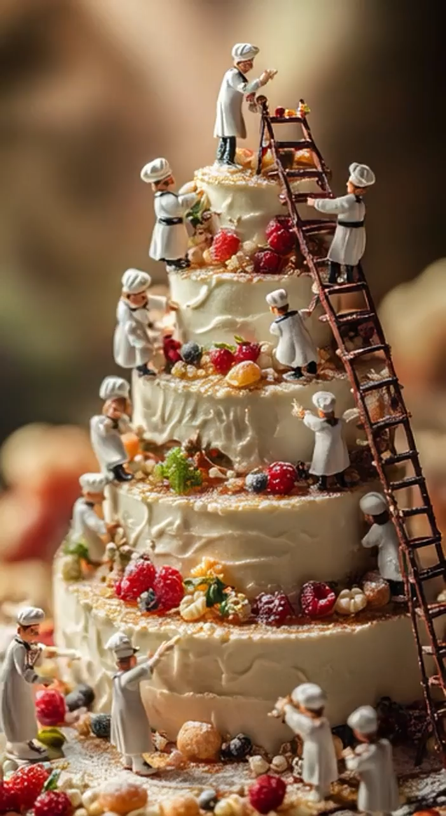

From Image to Video – Video Generation Models
Gemini Veo 3.1 (Closed Source)
OpenAI Sora (Closed Source)
Wan 2.1 Video (Open Source!)
Notes:
Recently, Large Scale text-to-Image denoising models have shown great advances in image quality and coverage.
These models take in noise maps, along with a text caption, and iteratively denoise these noise maps into images. Here we see some nice, diverse dog images.

Slide 3

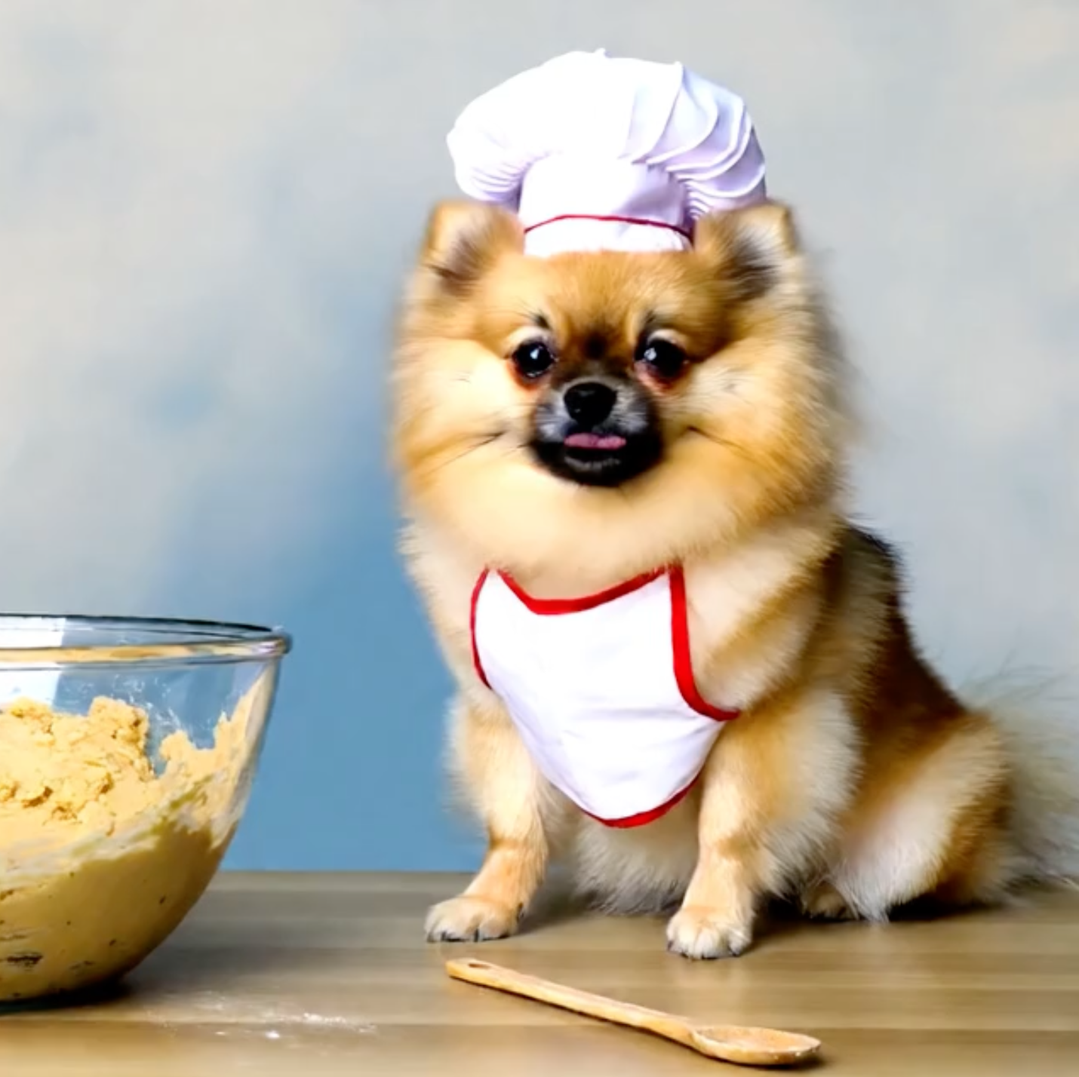
How Do Open Source (Image to) Video Models Work?
Single spatio-temporal noise map
Input Image
Indicator Masks
Time
Notes:
Recently, Large Scale text-to-Image denoising models have shown great advances in image quality and coverage.
These models take in noise maps, along with a text caption, and iteratively denoise these noise maps into images. Here we see some nice, diverse dog images.

Slide 4
How Do Open Source (Image to) Video Models Work?
Single spatio-temporal noise map
Input Image
Indicator Masks
Time
Patchify
Notes:
Recently, Large Scale text-to-Image denoising models have shown great advances in image quality and coverage.
These models take in noise maps, along with a text caption, and iteratively denoise these noise maps into images. Here we see some nice, diverse dog images.

Slide 5
How Do Open Source (Image to) Video Models Work?
3-way concat + flatten
Notes:
Recently, Large Scale text-to-Image denoising models have shown great advances in image quality and coverage.
These models take in noise maps, along with a text caption, and iteratively denoise these noise maps into images. Here we see some nice, diverse dog images.

Slide 6
How Do Open Source (Image to) Video Models Work?
Embed
Notes:
Recently, Large Scale text-to-Image denoising models have shown great advances in image quality and coverage.
These models take in noise maps, along with a text caption, and iteratively denoise these noise maps into images. Here we see some nice, diverse dog images.

Slide 7
How Do Open Source (Image to) Video Models Work?
“A video of a dog”
Self Attention Block
Text Encoder
Cross Attention Block
N Blocks
Per Token MLP
Notes:
Recently, Large Scale text-to-Image denoising models have shown great advances in image quality and coverage.
These models take in noise maps, along with a text caption, and iteratively denoise these noise maps into images. Here we see some nice, diverse dog images.

Slide 8
How Do Open Source (Image to) Video Models Work?
“A video of a dog”
Diffusion Transformer (DiT)
Text Encoder
Self Attention Block
Many Denoising Steps
Cross Attention Block
N Blocks
Per Token MLP
Notes:
Recently, Large Scale text-to-Image denoising models have shown great advances in image quality and coverage.
These models take in noise maps, along with a text caption, and iteratively denoise these noise maps into images. Here we see some nice, diverse dog images.

Slide 9
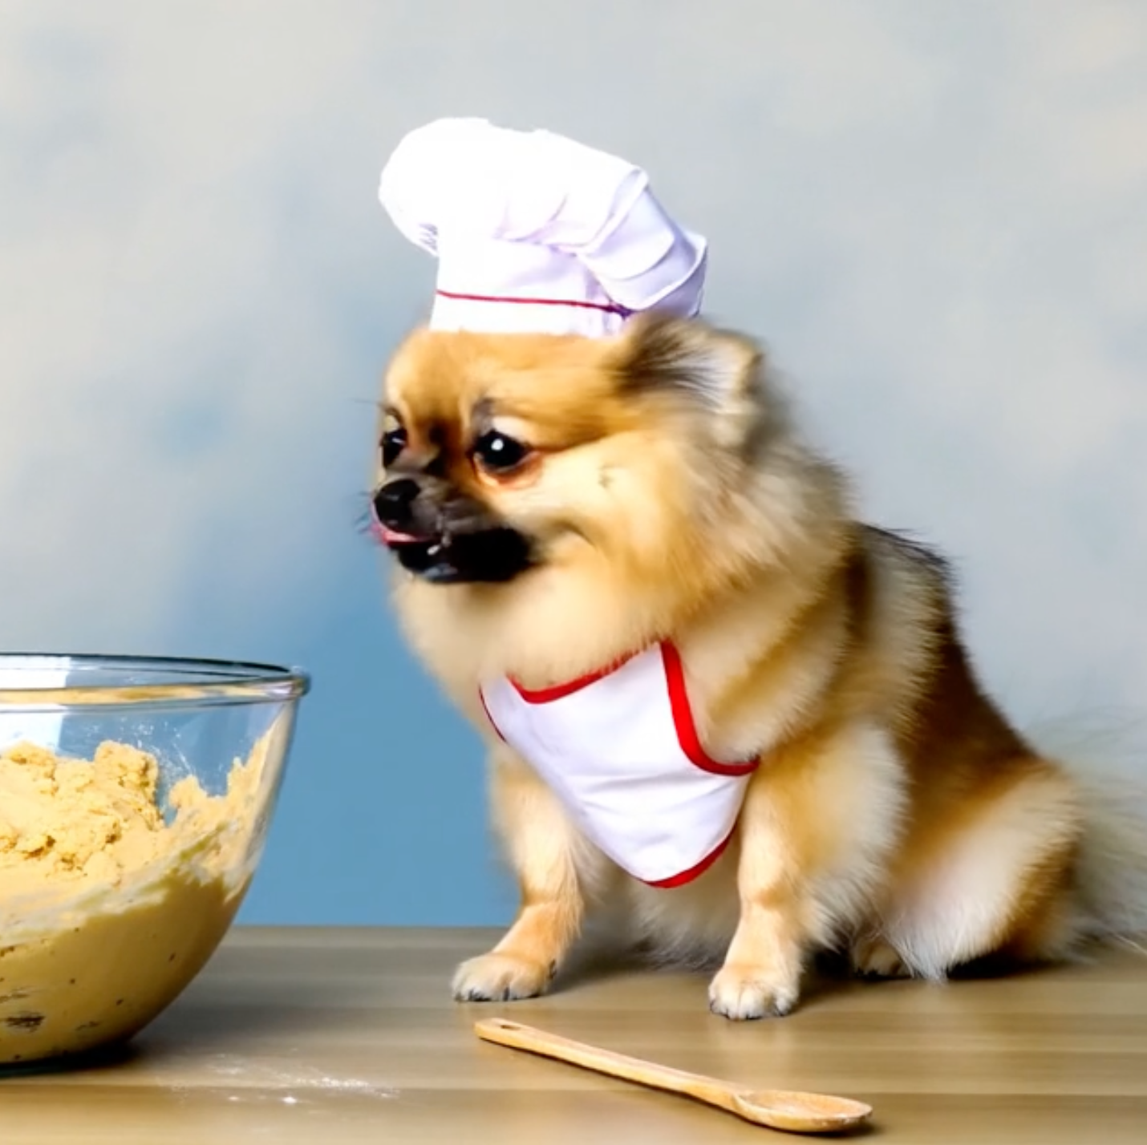
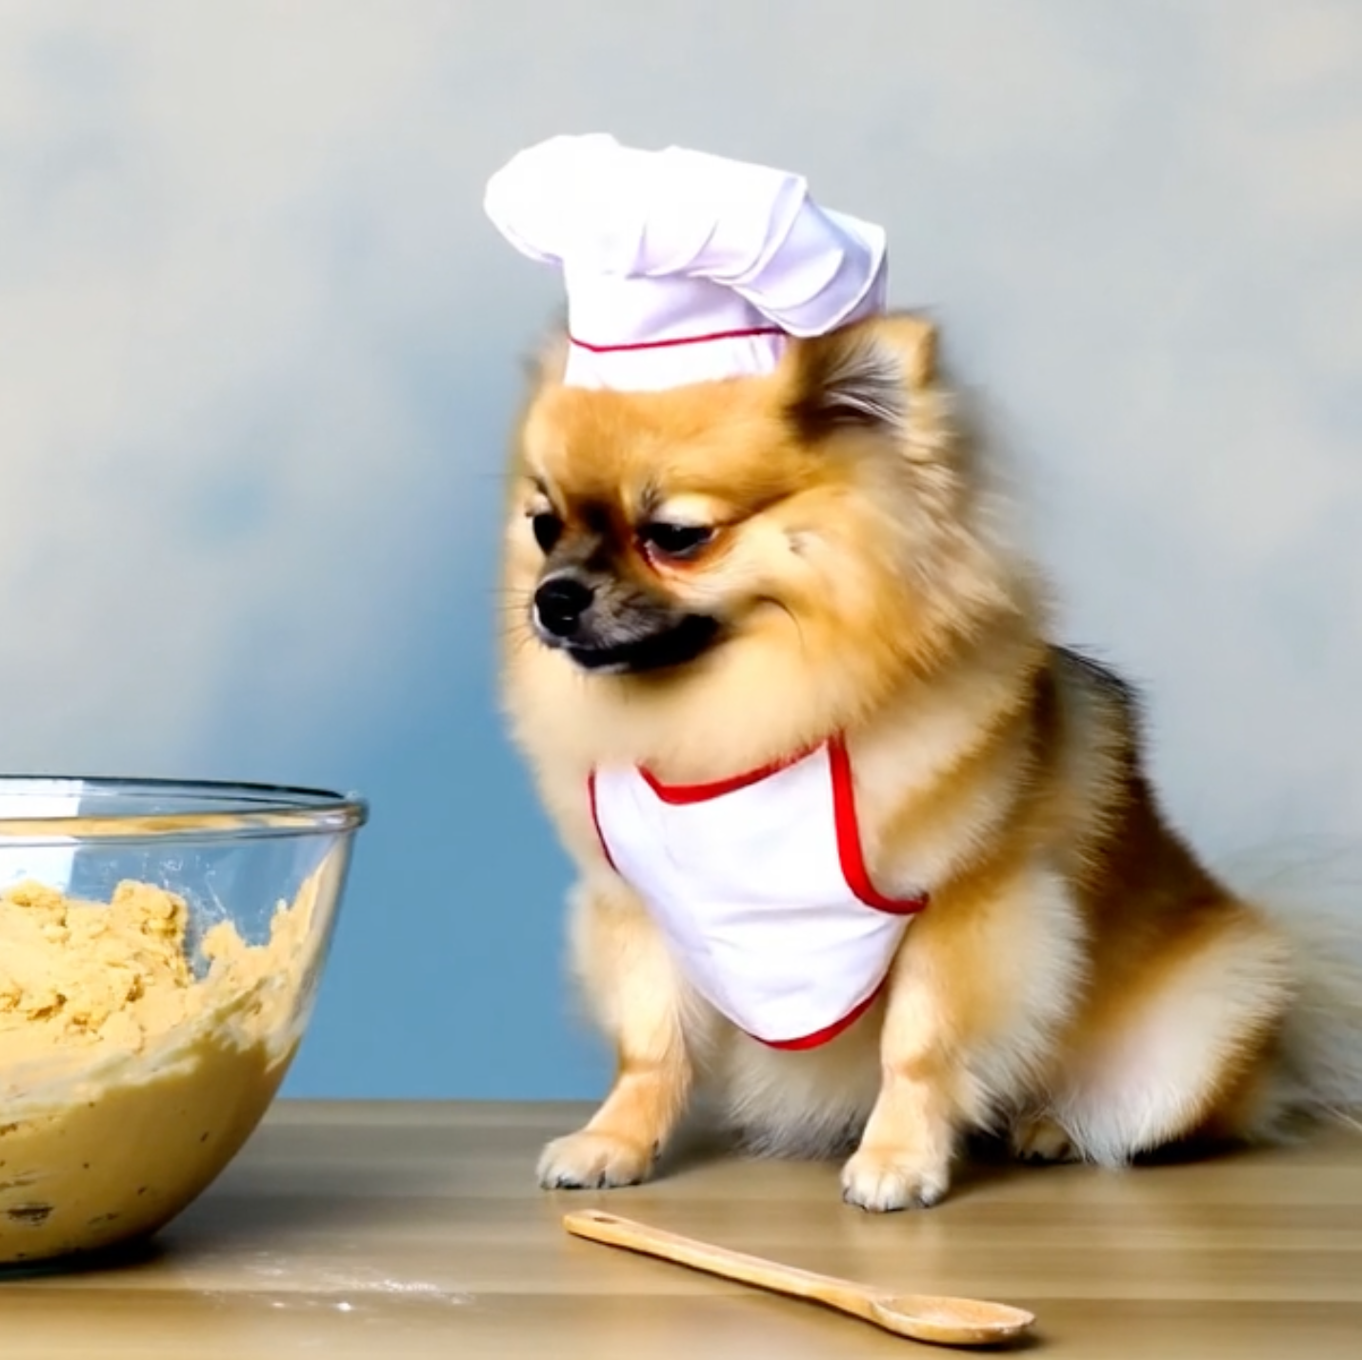
How Do Open Source (Image to) Video Models Work?
“A video of a dog”
Diffusion Transformer
Text Encoder
Self Attention Block
Many Denoising Steps
Cross Attention Block
N Blocks
Per Token MLP
Notes:
Recently, Large Scale text-to-Image denoising models have shown great advances in image quality and coverage.
These models take in noise maps, along with a text caption, and iteratively denoise these noise maps into images. Here we see some nice, diverse dog images.

Slide 10
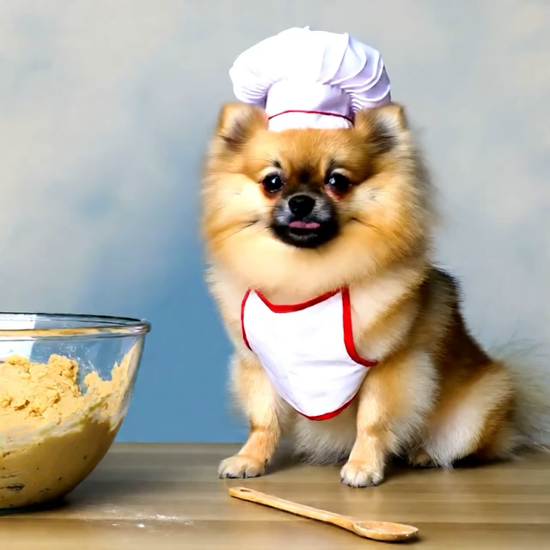
How Do Open Source (Image to) Video Models Work?
“A video of a dog”
Diffusion Transformer
Text Encoder
Self Attention Block
Many Denoising Steps
Cross Attention Block
N Blocks
Per Token MLP
Notes:
Recently, Large Scale text-to-Image denoising models have shown great advances in image quality and coverage.
These models take in noise maps, along with a text caption, and iteratively denoise these noise maps into images. Here we see some nice, diverse dog images.

Slide 11
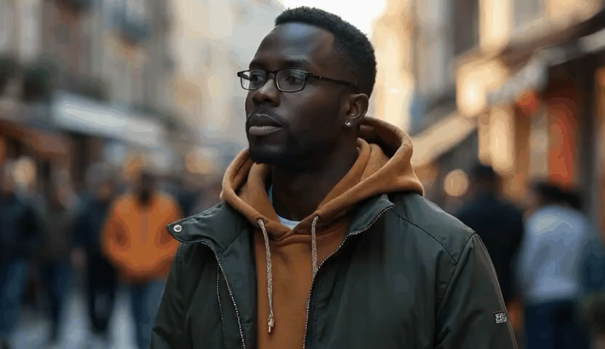
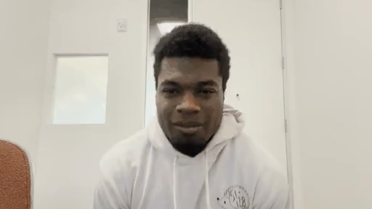
Now, What if we have a reference video effect and an input video and that we want to condition on?
Reference Effect Video
Input Video

Slide 12
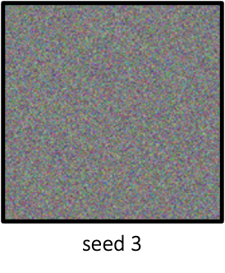

Updating Our Conditioning Mechanism
Noisy Latents
Conditioning Image + Padding
Conditioning Masks
Time
Channel Concat 3 Inputs,
Patchify, and Embed
“Turn them into a pirate“
Text Encoder
DiT Blocks
Output Video Noise Prediction
Tokens
(a) Wan Video I2V Inference

Slide 13



Updating Our Conditioning Mechanism
Frame Width-Wise
Latent Concat
Frame Width-Wise
Conditioning Latent Concat
Frame Width-Wise
Mask Concat
Noisy
Latents
Ref Video Latents
Input Video Latents
Ref Video Latents
Latents Conditioning Mask
Ref Latents Mask
Time
Channel Concat 3 Inputs, Patchify, and Embed
“Turn them into a pirate“
DiT Blocks
Text Encoder
Output Video Noise Prediction
Tokens
Discard Ref
Tokens
(b) Our Reference-Based V2V Inference

Slide 14
Updating Our Conditioning Mechanism
Frame Width-Wise
Latent Concat
Frame Width-Wise
Conditioning Latent Concat
Frame Width-Wise
Mask Concat
Replace Conditioning Image with Conditioning Input Video
Note: Change Indicator Mask to all 1s
Noisy
Latents
Ref Video Latents
Input Video Latents
Ref Video Latents
Latents Indicator Mask
Ref Latents Mask
Time
Channel Concat 3 Inputs, Patchify, and Embed
“Turn them into a pirate“
DiT Blocks
Text Encoder
Output Video Noise Prediction
Tokens
Discard Ref
Tokens
(b) Our Reference-Based V2V Inference

Slide 15
Updating Our Conditioning Mechanism
Frame Width-Wise
Latent Concat
Frame Width-Wise
Conditioning Latent Concat
Frame Width-Wise
Mask Concat
Concatenate The Reference Video to every frame width wise
NOTE: Now twice as many patches, self attention 4x as expensive
Noisy
Latents
Ref Video Latents
Input Video Latents
Ref Video Latents
Latents Conditioning Mask
Ref Latents Mask
Time
Channel Concat 3 Inputs, Patchify, and Embed
“Turn them into a pirate“
DiT Blocks
Text Encoder
Output Video Noise Prediction
Tokens
Discard Ref
Tokens
(b) Our Reference-Based V2V Inference

Slide 16
Updating Our Conditioning Mechanism
Frame Width-Wise
Latent Concat
Frame Width-Wise
Conditioning Latent Concat
Frame Width-Wise
Mask Concat
Discard Reference Video Tokens During Denoising loop after every generation
Noisy
Latents
Ref Video Latents
Input Video Latents
Ref Video Latents
Latents Conditioning Mask
Ref Latents Mask
Time
Channel Concat 3 Inputs, Patchify, and Embed
“Turn them into a pirate“
DiT Blocks
Text Encoder
Output Video Noise Prediction
Tokens
Discard Ref
Tokens
(b) Our Reference-Based V2V Inference

Slide 17
Generating a Training Dataset
Need Data Triplets of Form:
  (Input Video, Reference Effect Video, Input Video with Effect Applied)
Model Inputs
Model Target

Slide 18
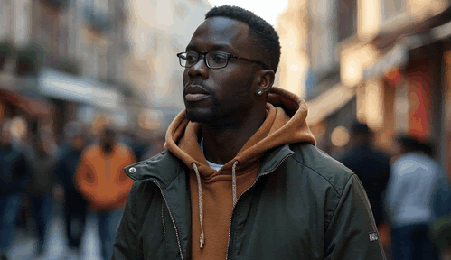
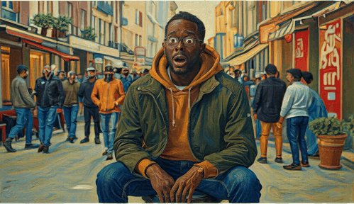
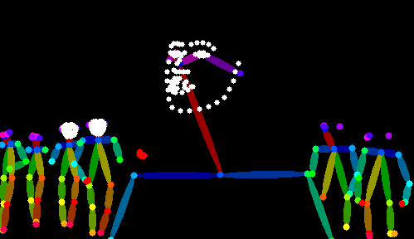

Custom Video to Video Algorithm
“A photo of a man”
“Change the man’s pose”
“Make it a Painting”
Image Generator
Image Editor
Image Editor
Initial Video
Last Frame
Final Video
First Frame
Final Video
Last Frame
Initial Video
First Frame
Conditional Video Generator
(First Last Frame to Video)
Conditional Video Generator
(First Frame + Intermediate Poses + Last Frame to Video)
Intermediate Poses
Pose
Extractor
Synthetic Video Pair

Slide 19
Full Algorithm + Examples
Idea: Sample prompt p, generate two pairs (V₁ , V₁’), (V₂ , V₂’)
Create Triplet (Ref Effect, Input Vid, Output Vid): (V₁’, V₂ , V₂’)

Slide 20

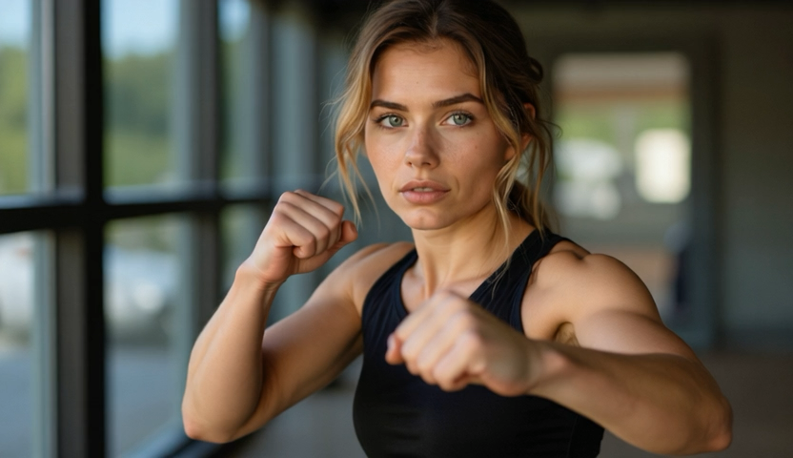

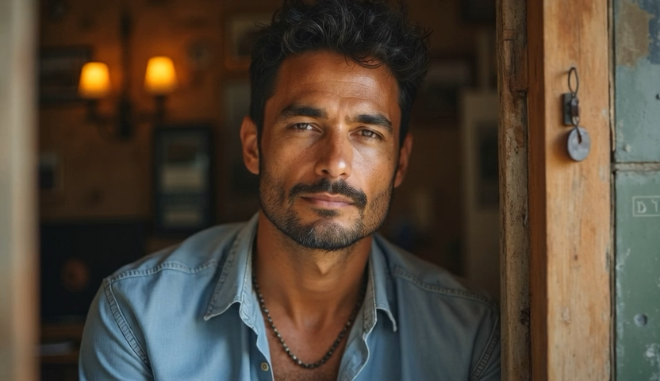


Full Algorithm + Examples
Idea: Sample prompt p, generate two pairs (V₁ , V₁’), (V₂ , V₂’)
Create Triplet (Ref Effect, Input Vid, Output Vid): (V₁’, V₂ , V₂’)

Slide 21
Data Augmentation: Code Based Effects
We can also create Reproducible Video Effects via Code
First, Sample from a fixed set of code effects
  (i.e. posterize, left wipe entrance, pixelate, circle out effect)
Next, pick random hyperparameters for the effect
  (i.e. start and end time, color combination, pixel size, etc)

Slide 22
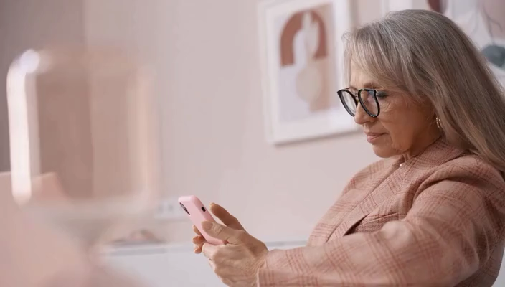


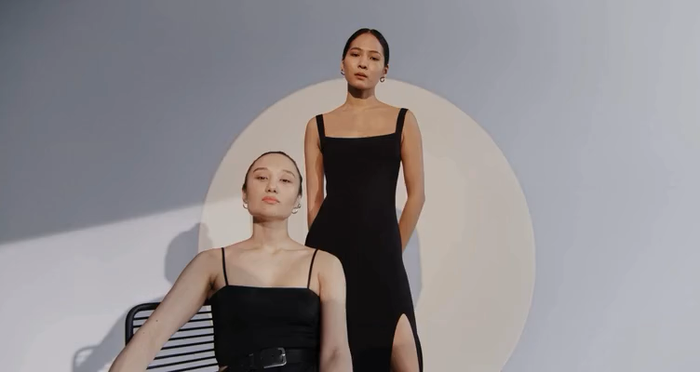
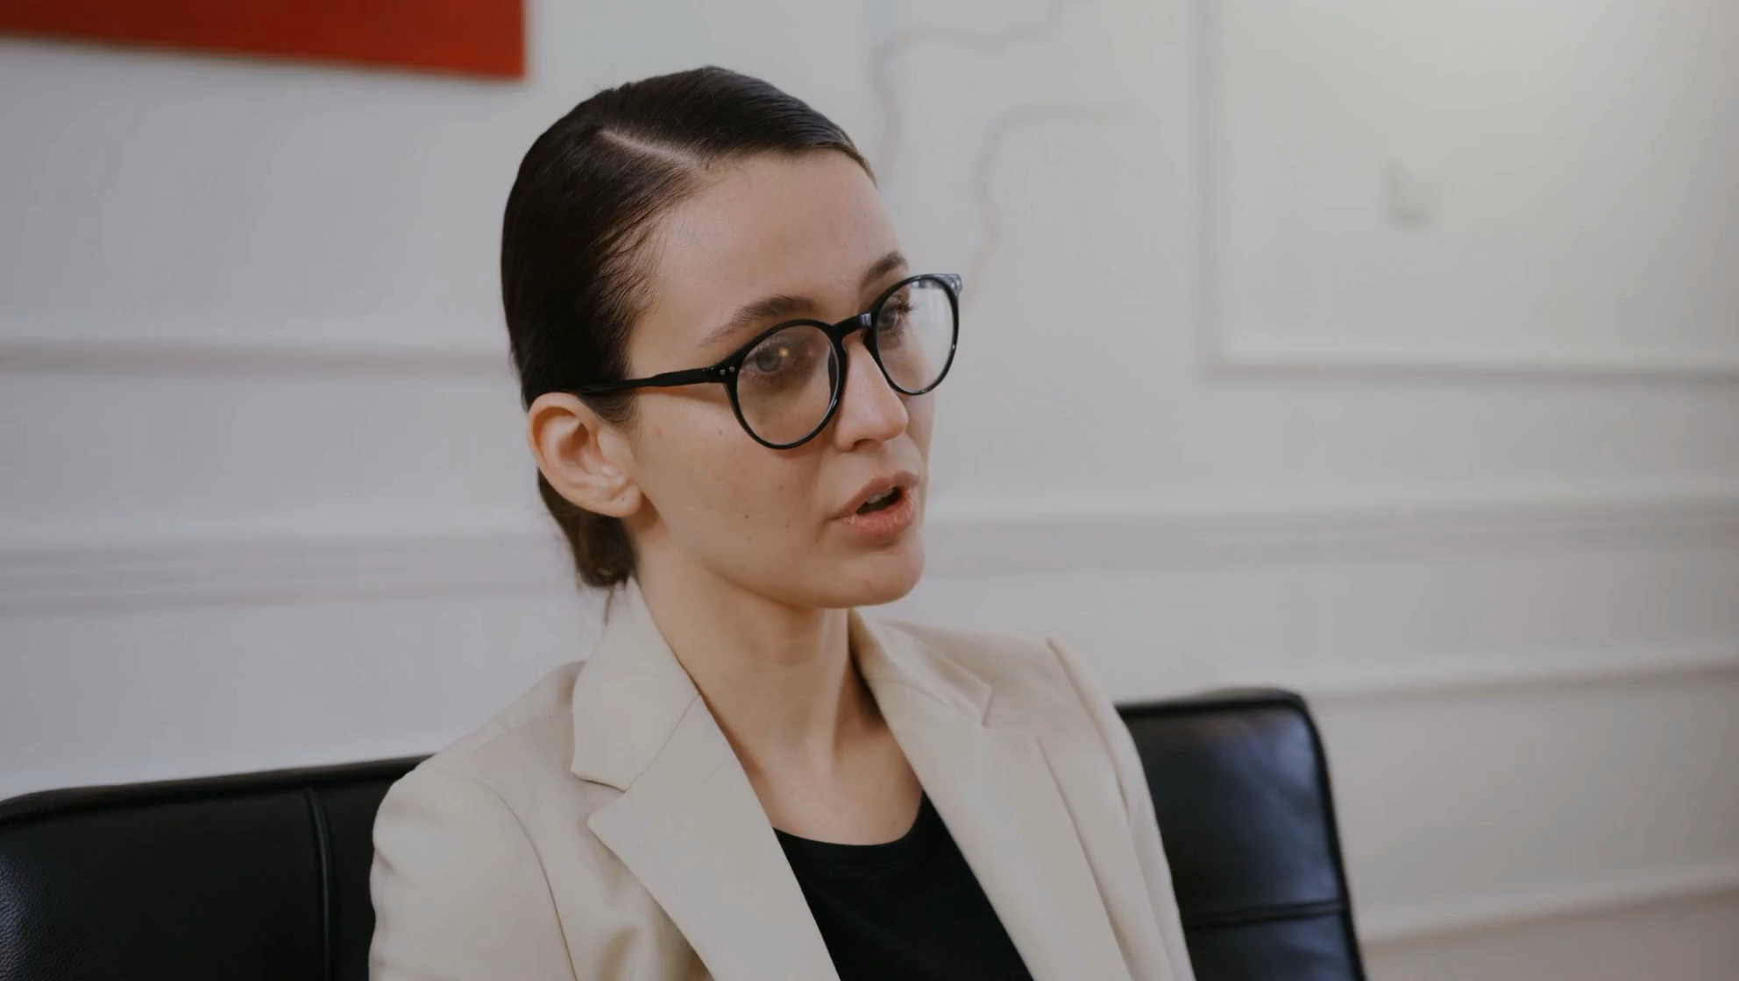
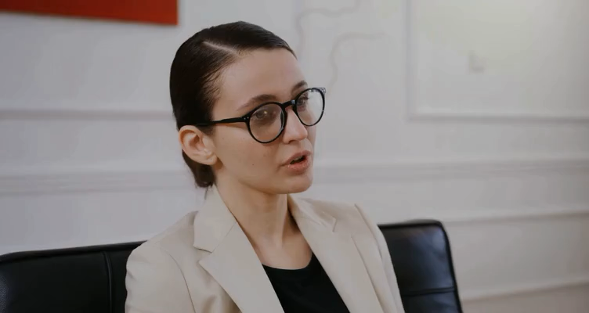
Data Augmentation: Code Based Effects

Slide 23



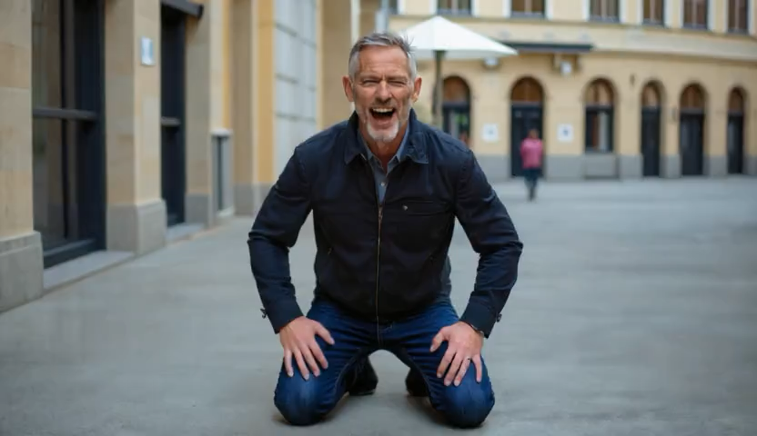
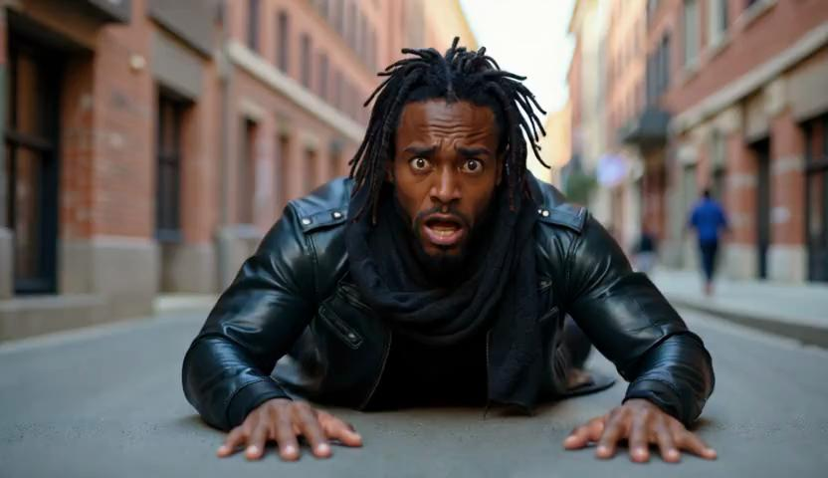

Data Augmentation: Ref Video + Image -> Video
We can use Reference effect I2V LoRAs to generate Consistent I2V Effects
  Sample two videos using an I2V LoRA, use one as ref, the other as first frame and target

Slide 24
Total Training Data
Data Subset | # of Types of Effects | # of Video Pairs | # of Pairs per Effect
Custom Video to Video | 143 | 14340 | ~100
Code Based Video to Video | 1517 | ~109000 | ~72
Image to Video | 43 | 14050 | ~327
Total | 1703 | ~137000 | ~80
Training: 10K Steps with batch size 8, sample all 3 datasets equally during training

Slide 25
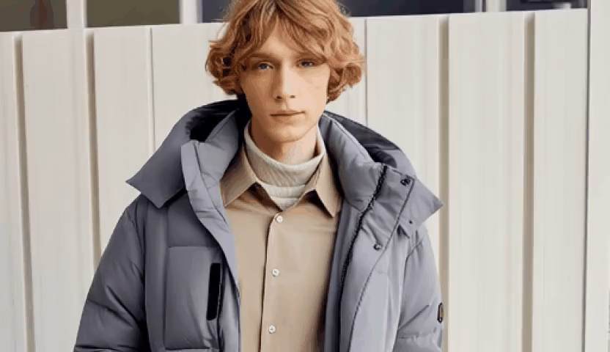



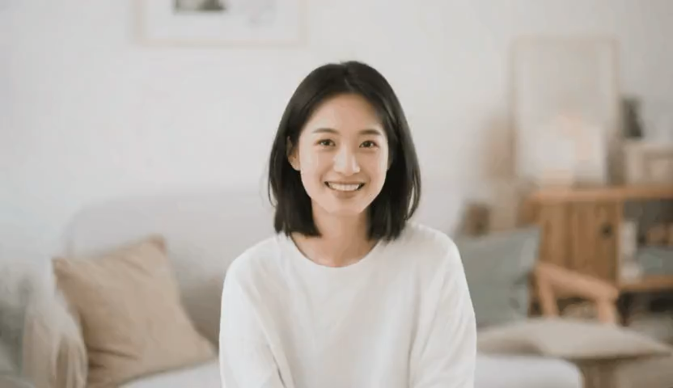





Results (Ref Video + Image -> Video)
Reference Effect Video
Input Image
Wan I2V
Wan VACE I2V
Ours
“… The subject turns into a younger version of themselves ... And rides a carousel …”
“… The subject gets ice cream poured on them … and the background becomes an ice cream landscape …”

Slide 26
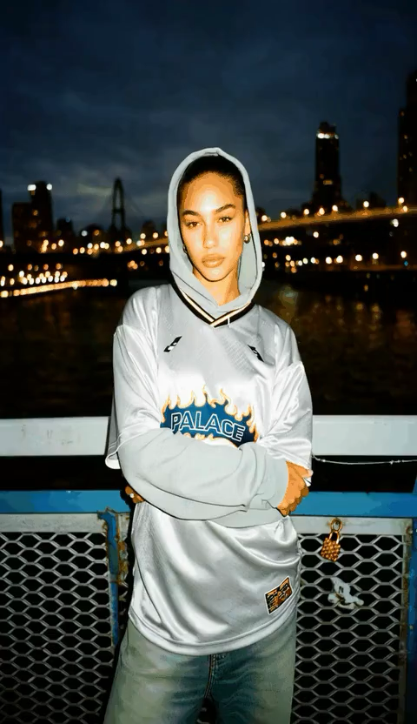
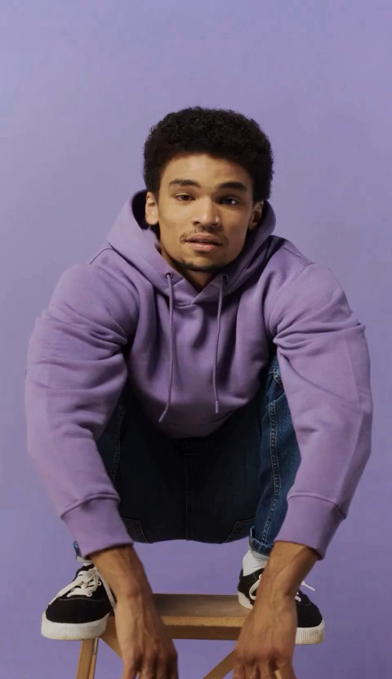
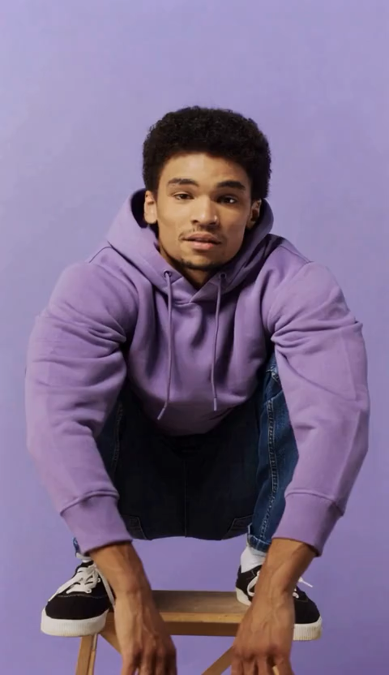
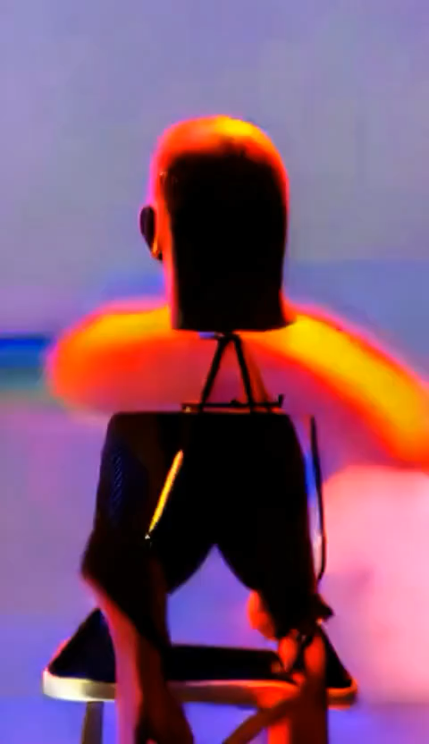
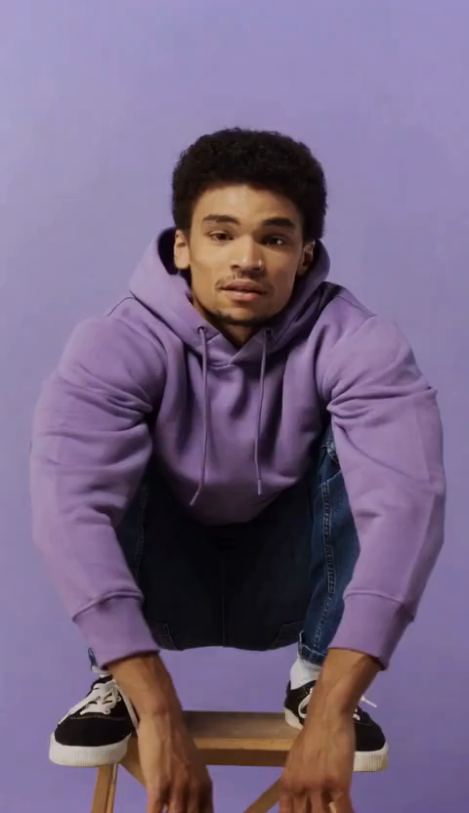
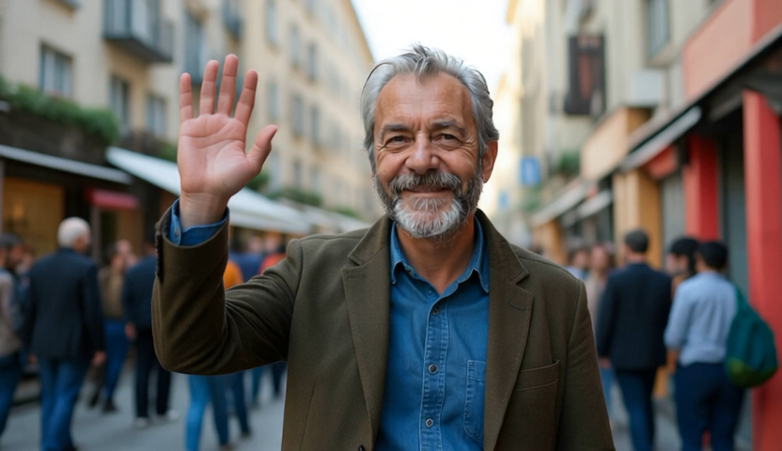


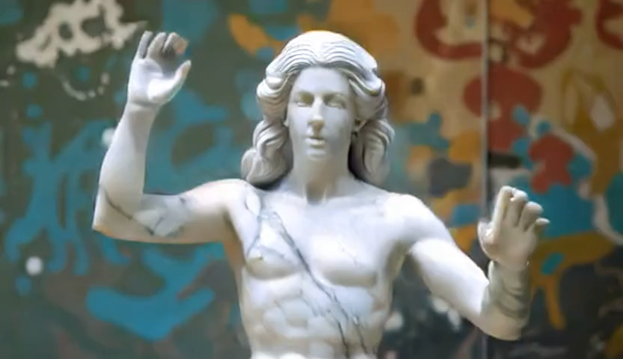
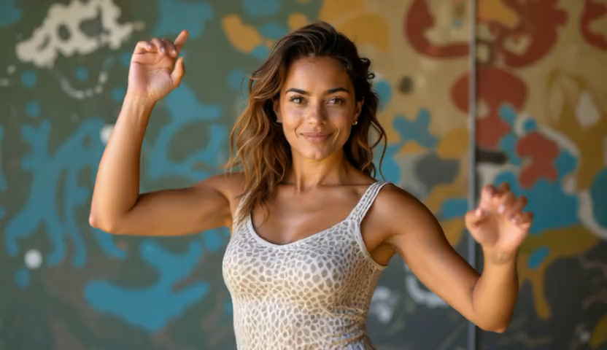
Results (Ref Video + Video -> Video)
Reference Effect Video
Wan VACE First Frame + Poses
Input Video
LucyEdit
Ours
“... An Acid Effect is applied to the person … ”
“… The person turns into a statue …”

Slide 27
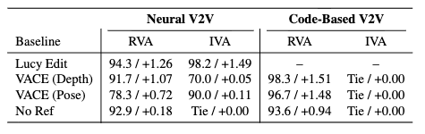
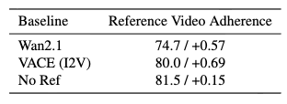
Results: User Study

Slide 28
Classifier Free Guidance Overview and Use
Let x be the current noisy image, and c be some conditioning
Remember that we use the noise prediction as a vector for the direction that we need to go to denoise the image
  i.e. why we have many steps even though we predict the full noise at every step

Slide 29
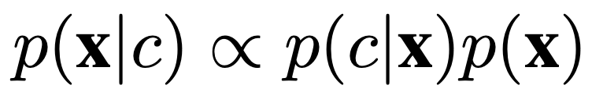
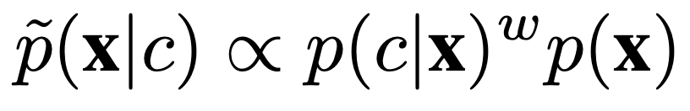
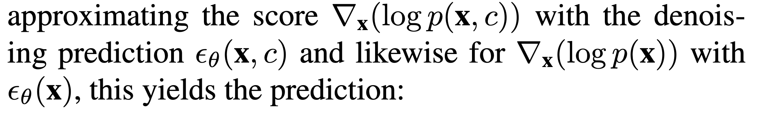
Bayes Rule
Updated Distribution
Log rules
Take Derivative
Bayes Rule Again
Diffusion/Flow Matching
Final CFG Formulation

Slide 30
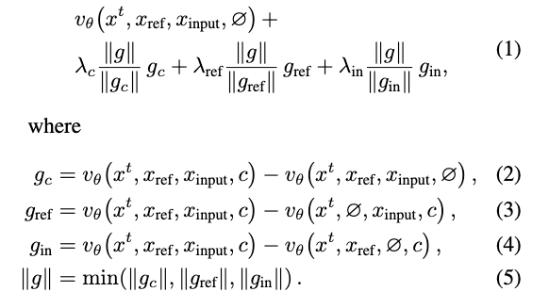
We have many inputs, so we can do this a lot… Also need to normalize vectors!!

Slide 31
Controllability across multiple w directions
Reference Effect Video
Input Video

Slide 32
